Slide 1
‘Helping Your Child Thrive’ Workshop for Parents
Primary Mental Health Team
Child and Adolescent Mental Health Service (CAMHS)

Slide 2
What to Expect from Today…
Ideas on how to build your child’s resilience
To know what to look out for regarding your child’s mental health
Ideas on talking to your child about mental health
Notes:
Please fill in level of confidence at beginning and end

Slide 3
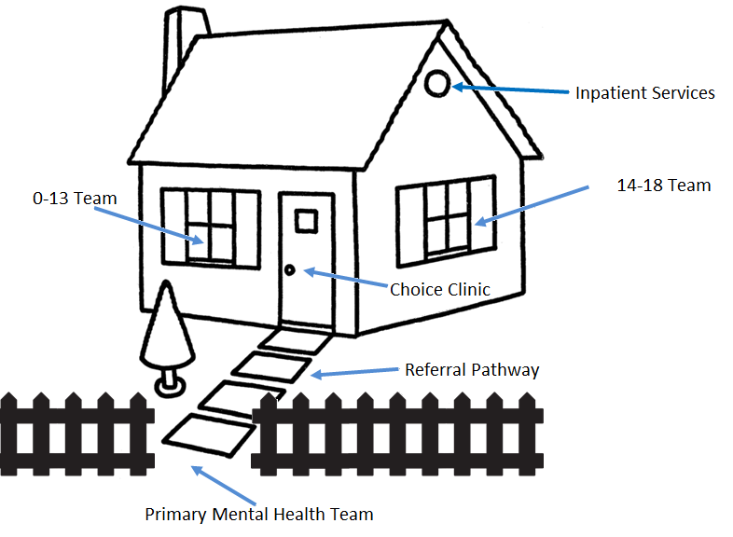
What is Wirral CAMHS?
LD CAMHS
LD CAMHS
LD CAMHS
LD CAMHS
LD CAMHS
LD CAMHS
Notes:
We are Primary Mental Health Team – gate keepers for CAMHS . CAMHS is a specialist mental health service for children who need a specialist service (severe mental illness)
Offer training/ consultations with professionals working with young people and families
Mental Health is everybody’s business – school. Family, community, children themselves
LD CAMHS set to appear on click or after 30 seconds.

Slide 4
What is Mental Health?
Being able to:
Develop and thrive
Make and keep friends, and understand what makes a good friend
Use and enjoy time on our own
Empathise with others
Play and learn
Develop a sense of right and wrong
Resolve problems and setbacks and learn from them
Notes:
Positive mental health is not about being happy, it is about being able to cope with difficulties. When might a child be unhappy without it being a mental health problem (normal reaction to circumstances or events)

Slide 5
Children with Additional Needs
children with additional needs might find it harder to:
be aware of their own mental health/ understand what is happening,
communicate how they are feeling,
cope with difficult feelings,
think about or follow plans to improve their mental health.
Therefore we might see more challenging behaviour or more signs of distress

Slide 6
What is Mental Health?
Notes:
Mental health continuum – we are all on here and we can all move up and down the continuum constantly.

Slide 7
What is Resilience?
Resilience: ‘the capacity to recover quickly from difficulties; toughness.’ (Oxford English Dictionary)
What Does Resilience Mean to Young People? https://youtu.be/4RzHx5rw0f4
Are children today resilient?
Notes:
video on resilience
Resilience means ability to bounce back, to adapt to circumstances, keep trying and not give up, to face adversity and grow from it, rise to the challenge
Are children resilient today – in pairs how is parenting now different from when we were kids?

Slide 9
Using the Resilience Framework
Use the framework to map out where your child is at
Pick your priorities to make the most resilient moves
Make the resilient moves
How well did it go?
What ideas do you have?

Slide 10
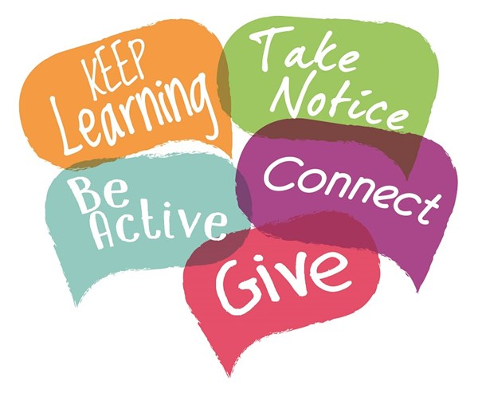
5 Ways to Mental Wellbeing
Connect – with other people, talk, spend time with family and friends
Be Active – physical exercise, walking,
Take Notice – ‘Be in the moment’, notice what’s going on around you in the present
Learn – do a crossword, read a book, learn a new skill, attend a workshop!
Give – help others, engage in your community
Notes:
Important for parents to stay mentally well in order to increase childs protective factors
what can we do to look after our mental wellbeing? Or talk it through in pairs

Slide 11
The Stress Bucket
Stress flows into the bucket
If the bucket overflows, problems develop - “snapping”
Vulnerability is shown by the size of the bucket
Helpful coping strategies = tap working lets the stress out
Unhelpful coping strategies = tap blocked so water fills bucket and overflows
11

Slide 12
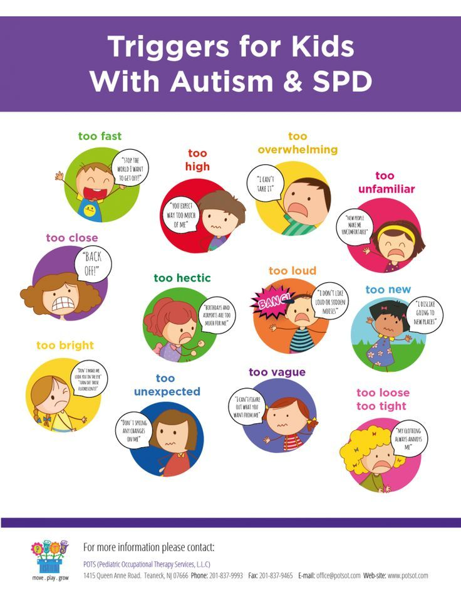
Notes:
Ringing a bell – examples – does it fit?
Things you might not notice for children with additional needs (lots of sensory stuff that you might not see but do impact) which may cause their bucket to fill quicker/had more stress in their bucket

Slide 13
What Helps?
Think of a time you have recovered from something (illness, life event, etc). What helped you recover?
Notes:
Think of when you recovered from something – could be an injury, illness, mental health difficulty, life event …
What helped your recovery – write 3 things down on post its and put the post it on a board in the room
When everyone has done this return to the board and see what the main things are that help us recover

Slide 14
Talking About Mental Health
https://www.youtube.com/watch?v=r_yAtOh3yV0
Anna Freud National Centre for Children and Families
Notes:
5 min video

Slide 15
How to Talk and How to Listen
Make talking about mental health a normal everyday part of life
Give it your full attention and take it seriously
Positive body language
Ask open questions
Stay calm
Offer empathy rather than solutions
Encourage your child to think of what might help (give them control)

Slide 16
How to Help Your Child Develop Resilience
Positive Attention- catch them doing something good
Labelled Praise - be specific about what you have liked i.e. ‘you walked to the house so nicely’, rather than ‘you’ve been good’
Rewards – more powerful than consequences
Enjoyable activities – having fun lifts our mood
Help them to achieve – builds self esteem
Plan for success – visual clues, preparation, choices
Clear boundaries – makes life more predictable
Help your child to understand / express emotions
Notes:
- All children like their parents’ attention at times. Try to show your child that you’re interested in them and the things they like to do. Smile, comment on what they’re doing (keeping language very simple and repetitive), imitate or join in if possible, try and get eye contact if possible. Even when things feel very difficult always try to find something positive to respond to
– Try and encourage even the smallest things your child does well, so they feel pleased with themselves and learn to enjoy praise. get the timing right!
Even very simple rewards such as a high five, a game of tickles, or a big smile can encourage behaviour to continue. Rewards are much more powerful than trying to use consequences for difficult behaviour. If you’re working to achieve a more demanding goal, the reward can be a little bigger, a food treat, a small toy, an outing etc. Use rewards immediately after the behaviour you are rewarding to help your child learn what it is they’re being rewarded for.
Sometimes it may be hard to find activities your child enjoys, or it can be tricky for them to participate in them regularly. But having fun and doing things we enjoy naturally lifts our mood
Helping your child to achieve manageable goals will build their self-esteem and help to lift their mood. Obviously the goal will need to be designed to be within your child’s capability
Plan your daily routine, activities and outings to give you and your child the best chance of a successful outcome. This may include preparation, visual cues, bringing specific items, allowing lots of time, offering support and encouragement, giving choices, knowing when to end etc.
Having consistent routines and boundaries help children to learn what is expected of them and makes their life more predictable. It may be tempting to bend the rules sometimes, but this can be confusing for children with learning disabilities or autism, and can make behaviour much more difficult in future.
All children learn from those around them, so if you label your own emotions, your child has a better chance of developing their understanding of emotions. If you can tell how your child is feeling, you can even label their emotions for them e.g. ‘I can see you’re feeling sad that we have to go home.’

Slide 17
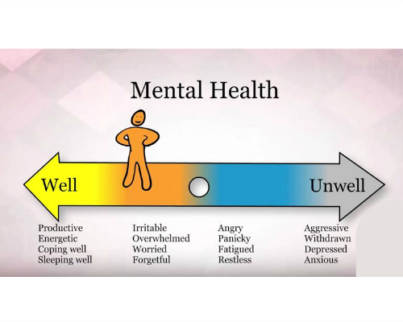
CAMHS Referral Criteria
Significant anxiety and/or low mood that’s impacting every day life
Regular self harm with thoughts of suicide
Significantly restricting food intake / binge eating
Severe reaction to traumatic event(s)

Slide 18
Stepped Approach to Supporting Your child
Step 1 – Talk, listen, empathise, encourage your child to find their own solutions and build resilience
Step 2 - MindEd – over 300 topics about mental health for parents (and professionals) www.minded.org.uk
Step 3 - CAMHS website www.mymind.org.uk for resources
Whilst – Liaising with school to develop support plans
Still Concerned? - CAMHS Advice Line – 0151 488 8453 (9am -10pm Mon – Friday, 12-8pm weekends and bank holidays)
Notes:
To recap - Talking to your child about feelings/emotions.
How do you and your child manage your stress buckets?
Help your child build resilience - Standing back and allowing your child to sort out their own problems
Managing our own emotions when our child is distressed.
Access more advice if required
Leaflets about advice line available and leaflets about talking about mental health

Slide 19
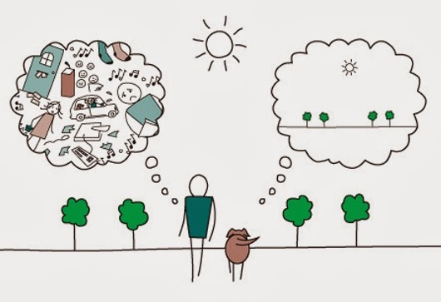
Mindfulness
3 min body scan
https://www.youtube.com/watch?v=ihwcw_ofuME
Notes:
Alternative – download Headspace on your phone

Slide 20
Thank you!
Any questions?
Please complete our evaluations
Interested in ‘train the trainer training’? Leave details on evaluation and we will be in touch!

